Slide 1
presentation BY: PA SEEDY Jammeh

Slide 2
Agenda
What is UTIs
Types of UTIs
Causes of UTIs
Symptoms of UTIs
Diagnosis of UTIs
Treatment of UTIs
Prevention of UTIs
Risk Factors of UTIs
Complications of UTIs
References
Question and Answer Session

Slide 3
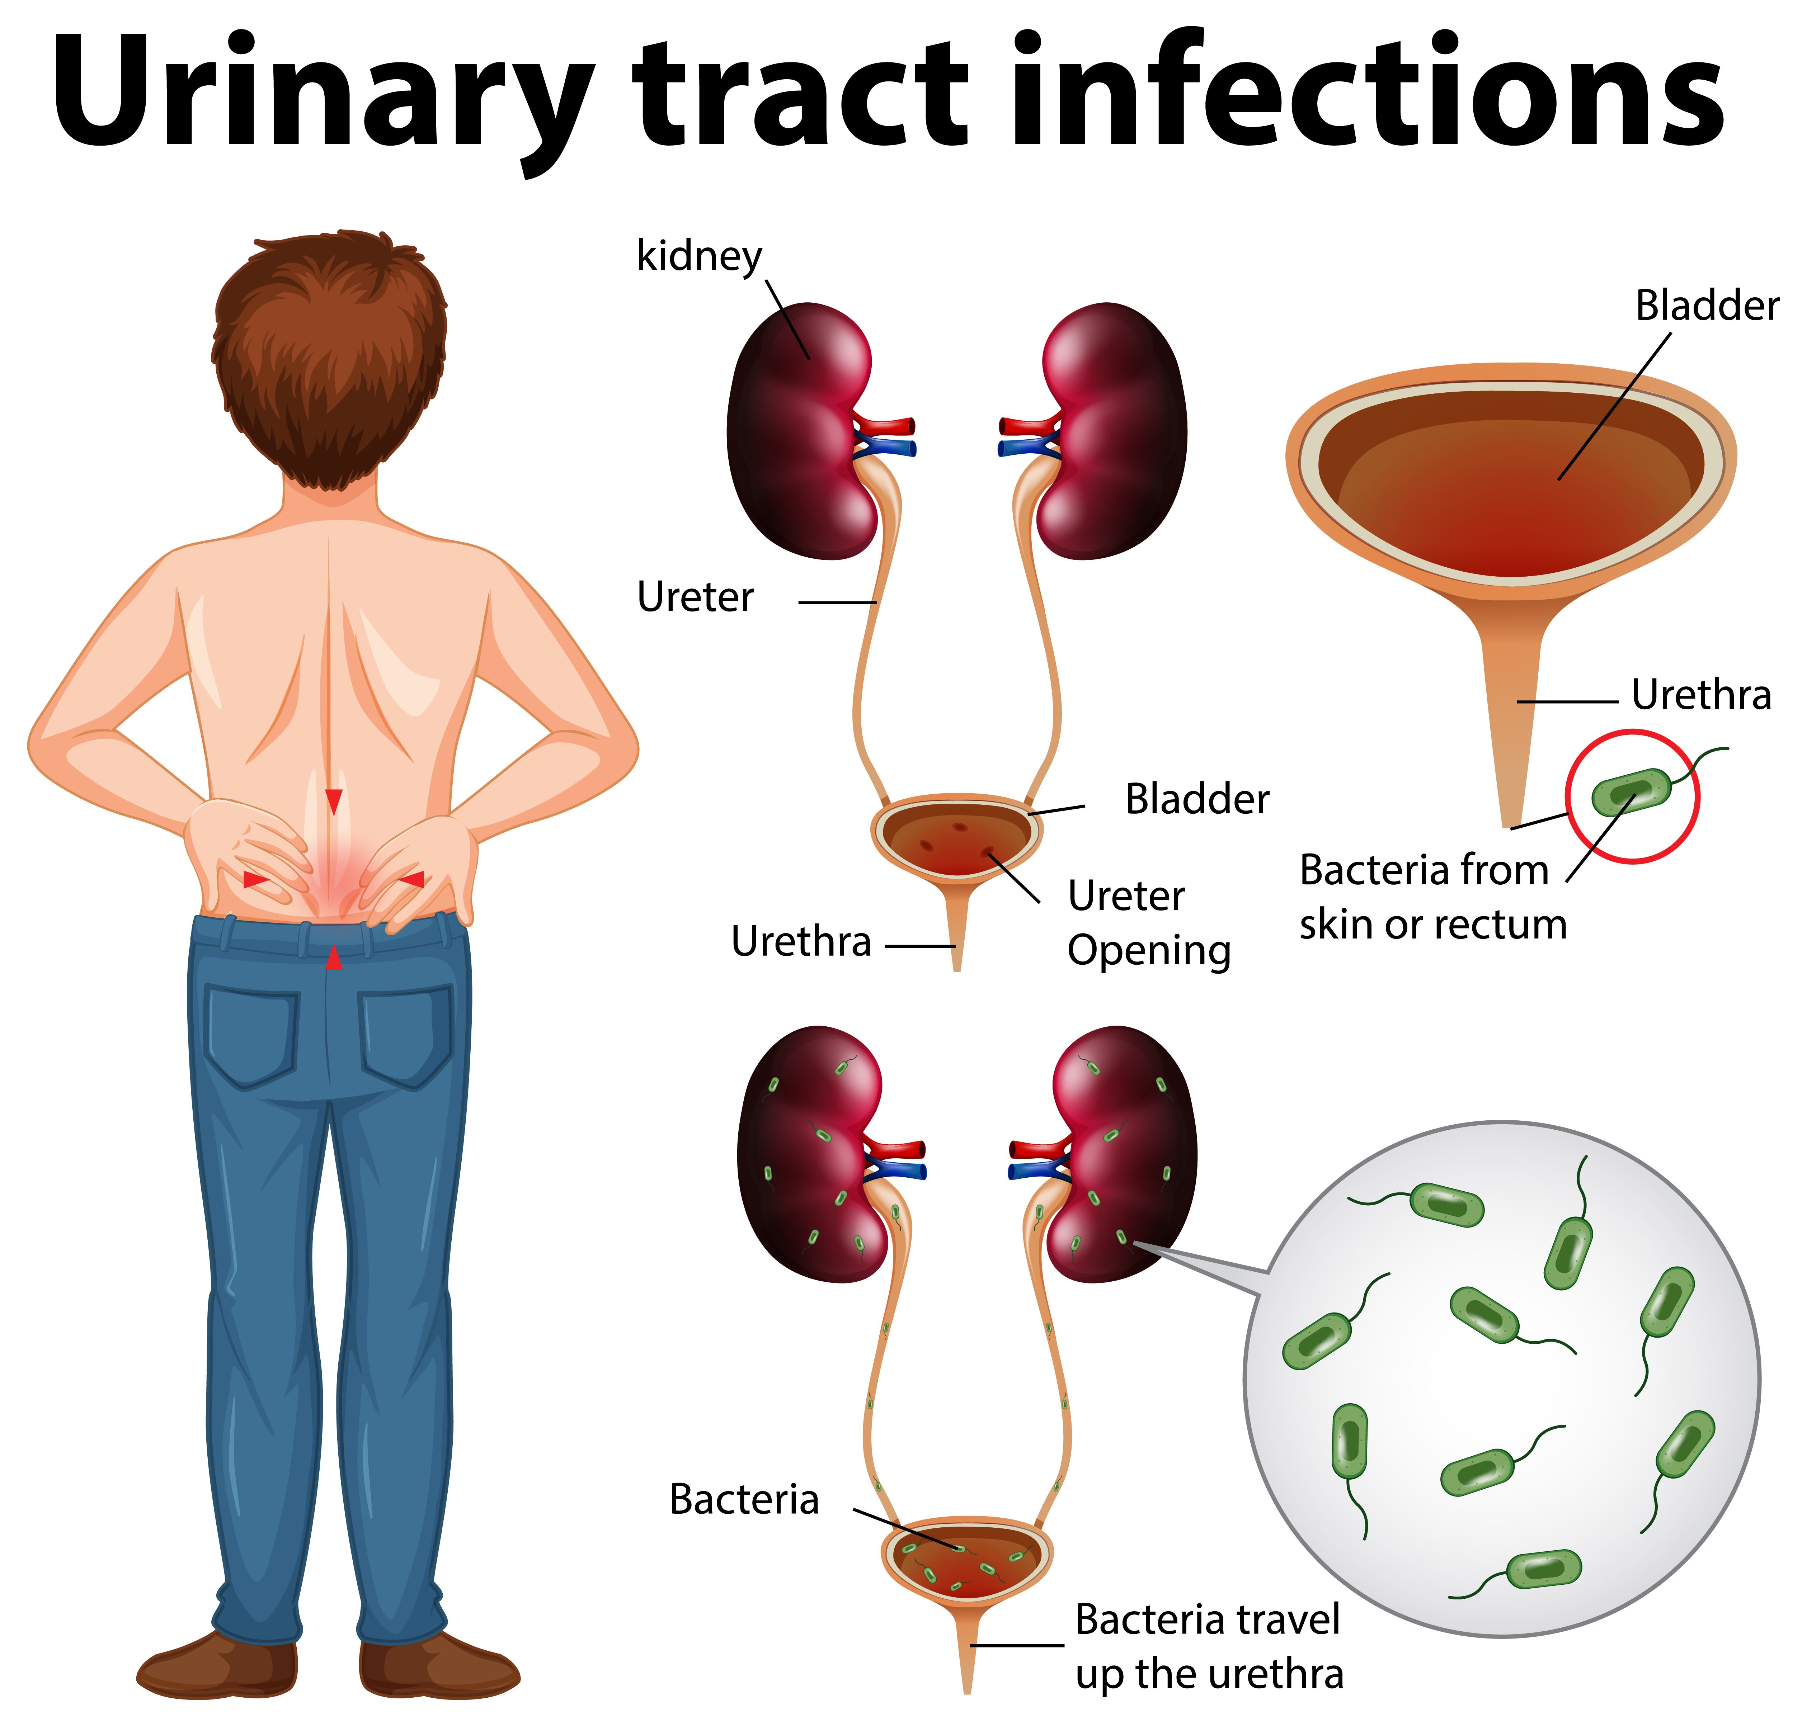
What is uti
Urinary Tract Infections (UTIs) are common infections that occur when bacteria, most often Escherichia coli (E. coli), enter and multiply in the urinary tract.
The urinary tract includes the kidneys, ureters, bladder, and urethra. UTIs can affect any part of this system but are most commonly found in the bladder and urethra.

Slide 4
Types of UTI
Cystitis (Bladder Infection):
Symptoms: Frequent urination, burning sensation, lower abdominal pain, and cloudy or bloody urine.
Common causes: Bacteria from the anal region traveling to the urethra.
Urethritis (Infection of the Urethra):
Symptoms: Burning during urination, discharge, and irritation around the urethra.
Causes: Bacteria or sexually transmitted infections like chlamydia or gonorrhea.
Pyelonephritis (Kidney Infection):
Symptoms: Fever, chills, back or side pain, nausea, and vomiting.
A more serious infection that requires prompt treatment.

Slide 5
Causes of Urinary Tract Infections
Narrowing it down to the Gambian level
Sharing of underwear
Sharing of Pads
Use of infected pads or objects
Use of washcloth (jampe)
Multiple sexual partners without a protection like a condom
Poor hygiene
Sexual activity
Use of spermicides or diaphragms
Reduced estrogen levels (common after menopause)
Obstructions (e.g., kidney stones or an enlarged prostate)
Catheter use or urinary procedures
A catheter-associated urinary tract infection (CAUTI) occurs when germs enter the urinary tract through a urinary catheter and cause infection.

Slide 6
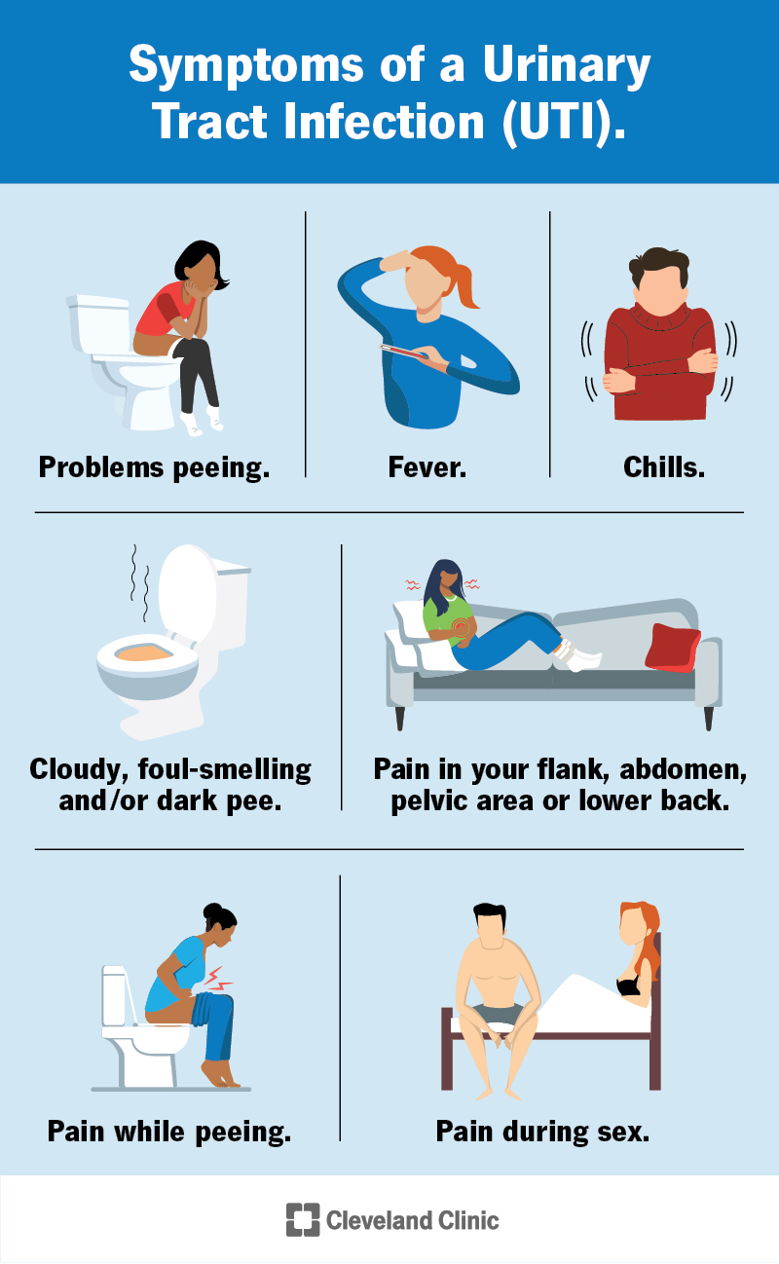
Symptoms of Urinary Tract Infections
Persistent urge to urinate
Passing small amounts of urine frequently
Pain or burning sensation while urinating
Cloudy, foul-smelling, or dark-colored urine
Pelvic pain (common in women)
Fever and chills (especially with kidney infections)
Picture extracted from Cleveland Clinic

Slide 7
Diagnosis of Urinary Tract Infections
Urine Analysis: Identifies bacteria, white blood cells, or blood in the urine.
Urine Culture: Determines the type of bacteria causing the infection.
Imaging: For recurrent or severe cases, an ultrasound or CT scan may be required.
Cystoscopy: Used in chronic or complicated infections to examine the bladder.

Slide 8
Treatment Urinary Tract Infections
Antibiotics:
Prescribed based on the severity and type of infection.
Common medications: Nitrofurantoin, Trimethoprim-sulfamethoxazole, Ciprofloxacin, or Amoxicillin.
Pain Relievers:
Pyridium (phenazopyridine) for symptom relief but does not treat the infection.
Hydration:
Drinking plenty of water helps flush out bacteria.
Severe Cases:
Hospitalization with intravenous antibiotics for kidney infections.

Slide 9
Prevention Urinary Tract Infections
Hydrate: Drink at least 8 glasses of water daily.
Catheter us: If the patient has a long-term catheter, they must clean their hands before and after touching the catheter.
Urinate Regularly: Don’t hold urine for long periods.
Hygiene:
Wipe front to back after using the restroom.
Avoid harsh feminine products like douches or sprays.
Urinate After Sex: Helps flush out bacteria.
Clothing: Wear breathable, cotton underwear, avoid sharing, rush to the hospital if you see any symptom or at risk and avoid tight-fitting clothes.
Probiotics: May help maintain a healthy balance of bacteria in the urinary tract.
Picture extracted from North Houston Cancer Clinics

Slide 10
Risk Factors Urinary Tract Infections
Being female (shorter urethra makes it easier for bacteria to reach the bladder)
Pregnancy
Menopause
Use of contraceptive devices
Diabetes
Immune suppression

Slide 11
Complications Urinary Tract Infections
Untreated UTIs can lead to:
Recurrent infections
Permanent kidney damage
Sepsis (life-threatening infection spreading to the blood)
PREVENTION
IS
BETTER
CURE

Slide 12
References
CDC - Urinary Tract Infection (UTI): Centers for Disease Control and Prevention. (n.d.). Urinary tract infection (UTI). Retrieved from https://www.cdc.gov
Mayo Clinic - Urinary Tract Infection: Mayo Clinic. (n.d.). Urinary tract infection (UTI). Retrieved from https://www.mayoclinic.org
Mr. Ndow. (2023). Reproductive and family health [Lecture notes]. Department of Public and Environmental Health, University of The Gambia.
Mr. Bah. (2023). Vector control [Lecture notes]. Department of Public and Environmental Health, University of The Gambia.
. Dr. Evelyn. (2023). Medical parasitology [Lecture notes]. Department of Public and Environmental Health, University of The Gambia.
Dr. Bajinka. (2022). Biochemistry [Lecture notes]. Department of Public and Environmental Health, University of The Gambia

Slide 13
Thank you
Question and Answer Session

